Slide 1



Slide 2
A REPORT ON ONLINE MEDICAL MANAGEMENT SYSTEM
By
N.HARSHA VARDHAN M.ESWAR KALYAN
(16341A05C6) (16341A05B9)
Under the esteemed guidance of
P.MEGHANA BALA
CASPIAN TECHNOLOGIES
VISAKHAPATNAM

Slide 3
CONTENTS
ABSTRACT
INTRODUCTION
REQUIREMENTS
PROJECT EXECUTION AND SCREENSHOTS
CONCLUSION

Slide 4
ABSTRACT
Our project Online Hospital Management system includes registration of patients, storing their details into the system. Our software has the facility to give a unique id for every patient and stores the details of every patient and the doctors automatically. The Online Hospital Management System can be entered using a username and password. It is accessible either by an administrator or doctors. Only they can add data into the database. The data can be retrieved easily. The interface is very user-friendly. The data are well protected for personal use and makes the data processing very fast and can get a printout regarding the diagnosis and prescription. This project is mainly concentrated with the storage of patients details and prescription details.

Slide 5
INTRODUCTION
Hospitals currently use a manual system for the management and maintenance of critical information. The current system requires numerous paper forms, with data stores spread throughout the hospital management infrastructure. Often information (on forms) is incomplete, or does not follow management standards. Forms are often lost in transit between departments requiring a comprehensive auditing process to ensure that no vital information is lost. Multiple copies of the same information exist in the hospital and may lead to inconsistencies in data in various data stores. A significant part of the operation of any hospital involves the acquisition, management and timely retrieval of great volumes of information. This information typically involves; patient personal information and medical history. All of this information must be managed in an efficient and cost wise fashion so that an institution's resources may be effectively utilized HMS will automate the management of the hospital making it more efficient and error free. It aims at standardizing data, consolidating data ensuring data integrity and reducing inconsistencies The Online Hospital Management System (OHMS) is designed

Slide 6
REQUIREMENTS
Pc with windows or ios
Php
Chrome browser
Mysql

Slide 7
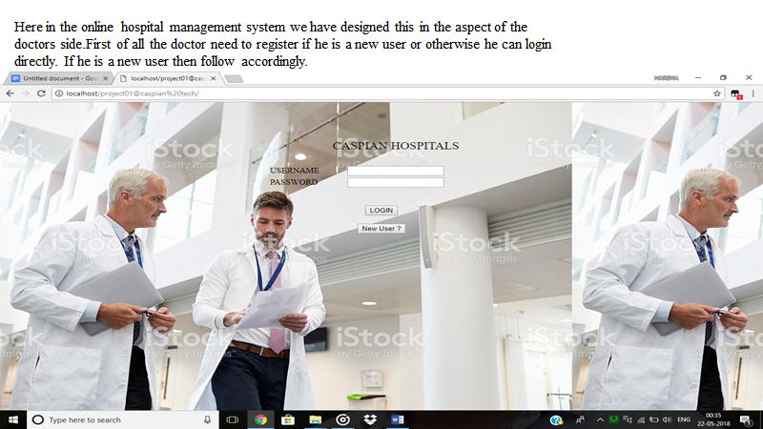

Slide 8
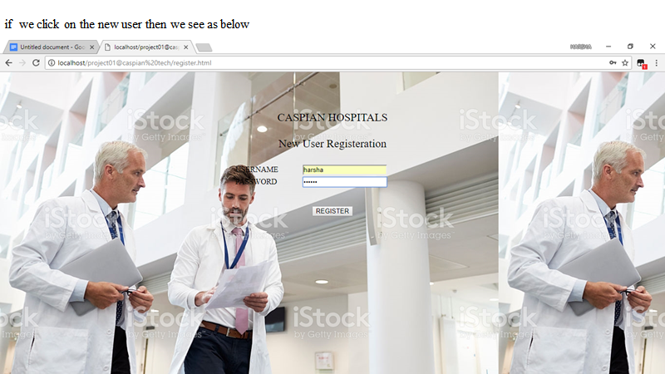

Slide 9
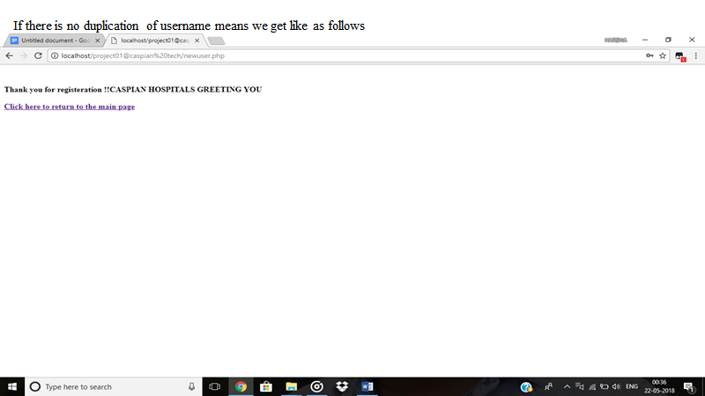

Slide 10
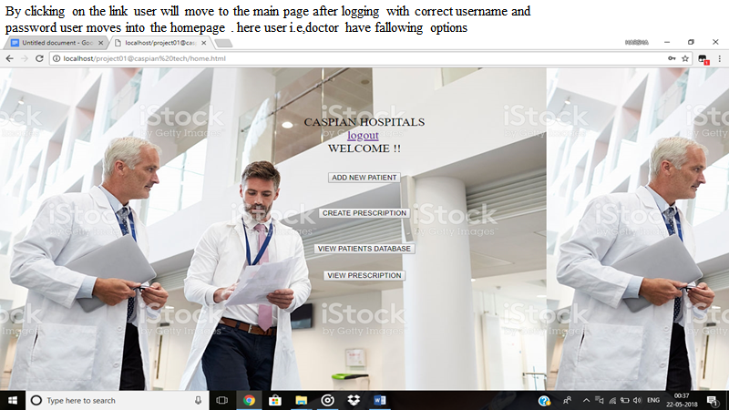

Slide 11
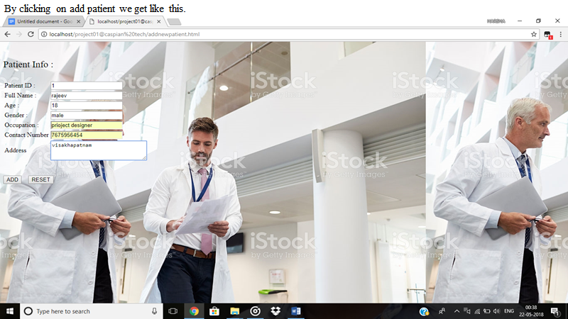

Slide 12
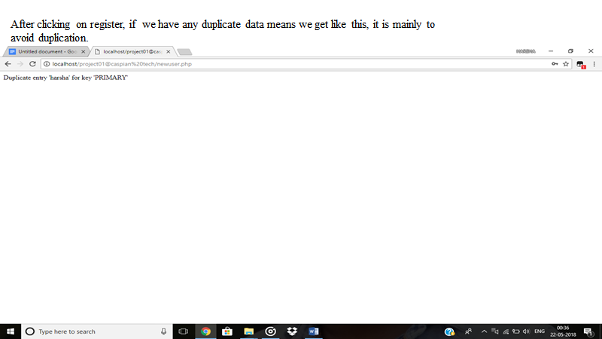

Slide 13


Slide 14
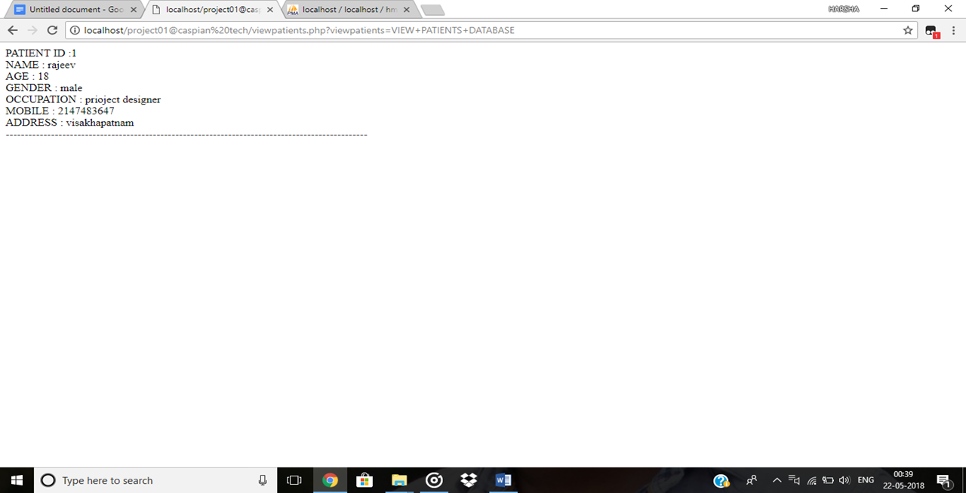

Slide 15
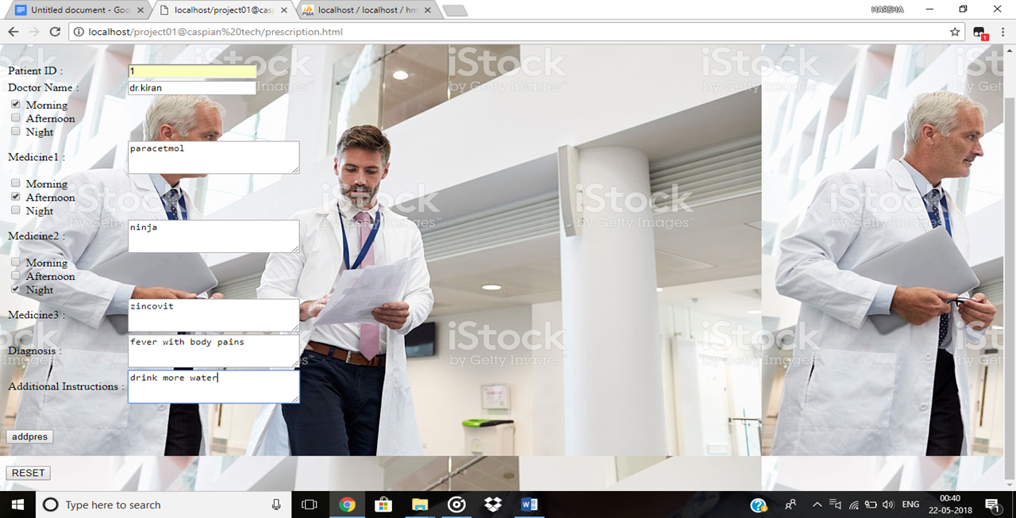

Slide 16


Slide 17
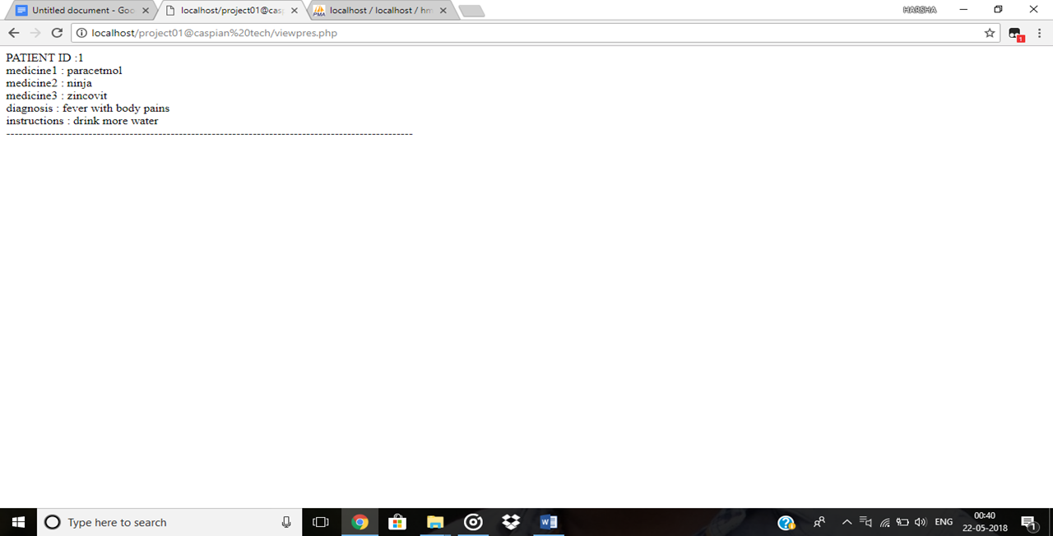

Slide 18
CONCLUSION
The whole systems activities are divided into three major parts like patients, doctors, and admin. Each one has their own role to perform and system respond accordingly. Several agents have been created using web services and inter agent communication is done. Different ontologies have been created for different purpose. For implementing the system html, CSS ,wamp servers are used. In this system ontology plays similar role. The system comprise of following features. Management of Doctors Management of Patients Management of Schedules.
Conclusion & Future Scope A Methodical Approach for Communication & Co-operation between agents using Ontology for Healthcare Page Management of Patient Doctor Dialogs Services supported by hospitals Managing Reports Feedbacks Management Inquiry Management Specialty Management Searching Information Managing useful information in form of News Management of Patient‘s prescription and its information
Finally all the operations discussed in the above sections are useful for the development of the project named “online hospital management system” and meeted the required specifications

Slide 19
THANK YOU

